Slide 1
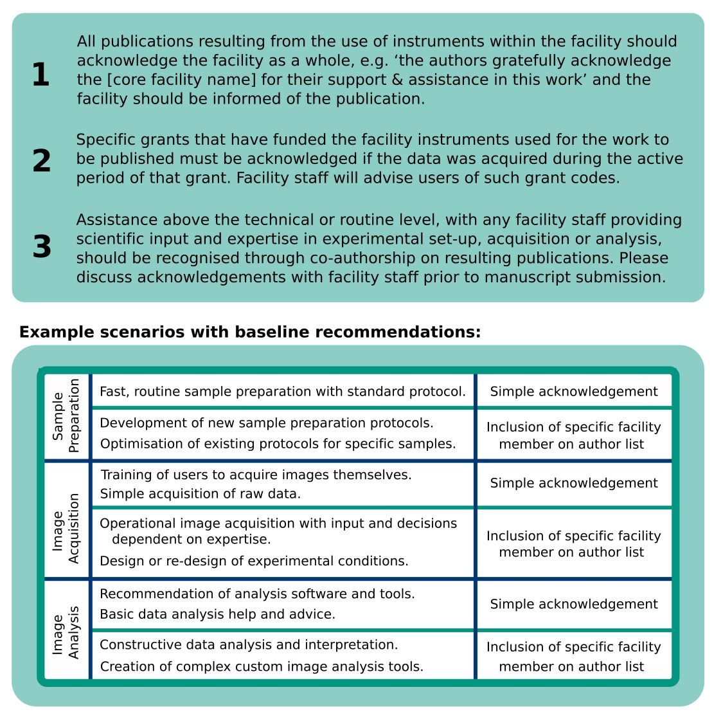
LTRI Core Facility Policy regarding Acknowledgments

